Slide 1
Insertion Loss and Return Loss Testing of Complex Cable Assemblies
Notes:
Optotest has chosen to partner with 3M to help showcase their new EBO connector. Paul Leblanc will be presenting on their behalf. Paul would you like to introduce yourself?

Slide 2

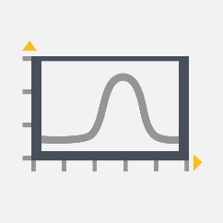



OptoTest Overview
Designing fiber optic test equipment for over 15 years
Tailor test equipment to the needs of the customer
Partner with industry innovators to develop adapters/solutions for the newest optical connectors and components
We take pride in simplifying the test and measurement process for our customers to help increase efficiency
Dedicated to producing reliable, responsive, and accurate test equipment
Our products are designed and manufactured in the USA
We are ISO 9001:2015 compliant

Slide 3
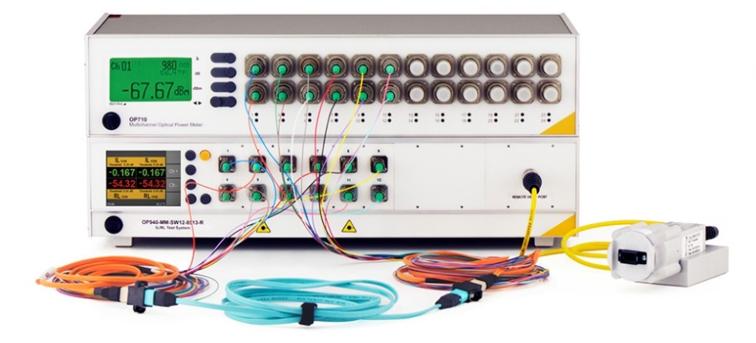
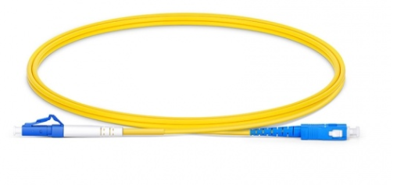
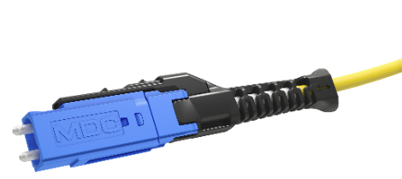
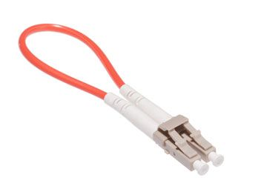
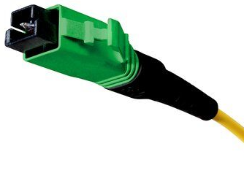
Webinar Overview
In this webinar we will look at:
Equipment options for IL and RL testing of fiber optic assemblies
Methods to test
  Hybrid patch cords (SC-LC)
  New unibody duplex connectors (CS, SN, MDC)
  Loopback assemblies
    Duplex
    MPO
  Shuffle assemblies
  Expanded beam
    EBO

Slide 4
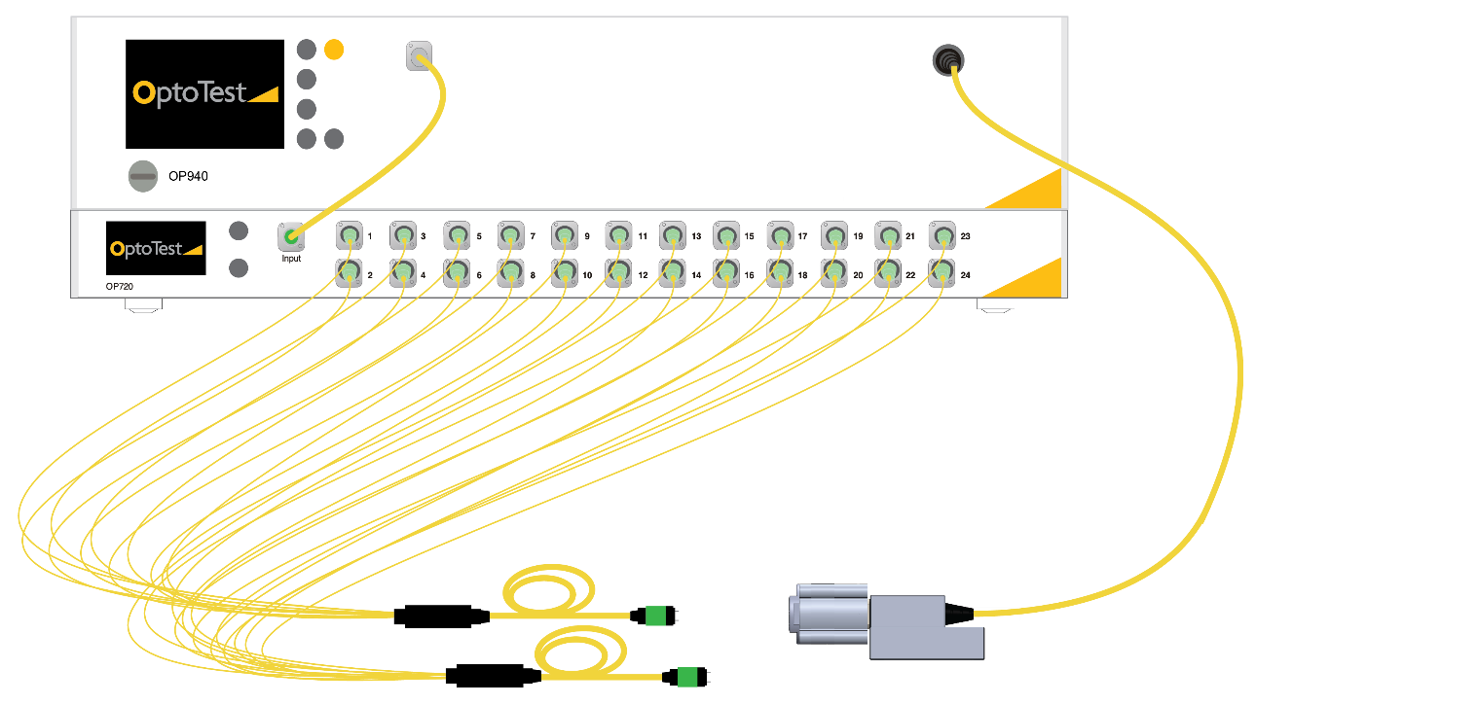
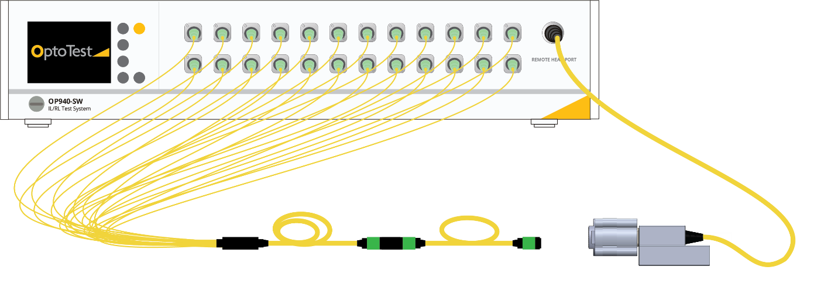
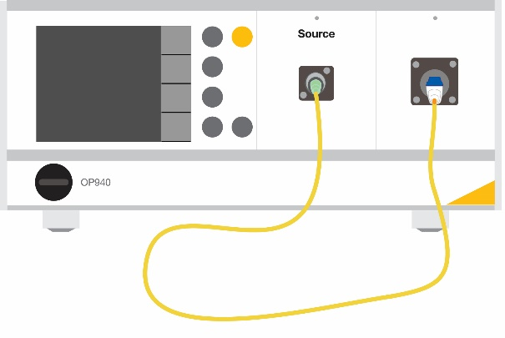
Equipment Selection
Insertion Loss and Return Loss Meter
Three different configurations:
Simplex with external switch
Simplex
Multichannel
Notes:
Simplex system good for: Simplex assemblies, hybrid cables, some duplex cables.
Multichannel: Integrated switch for multifiber assemblies, small foot print

Slide 5
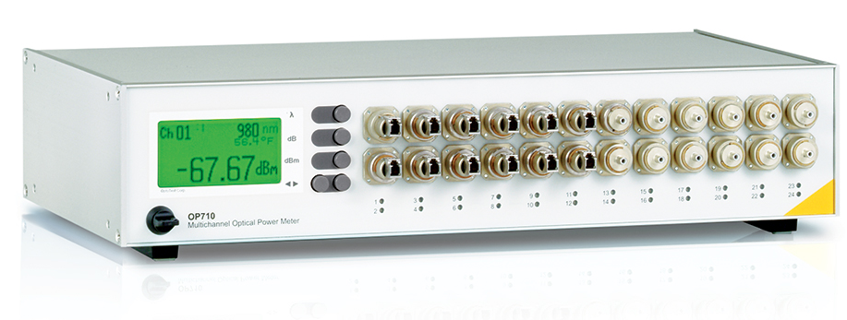
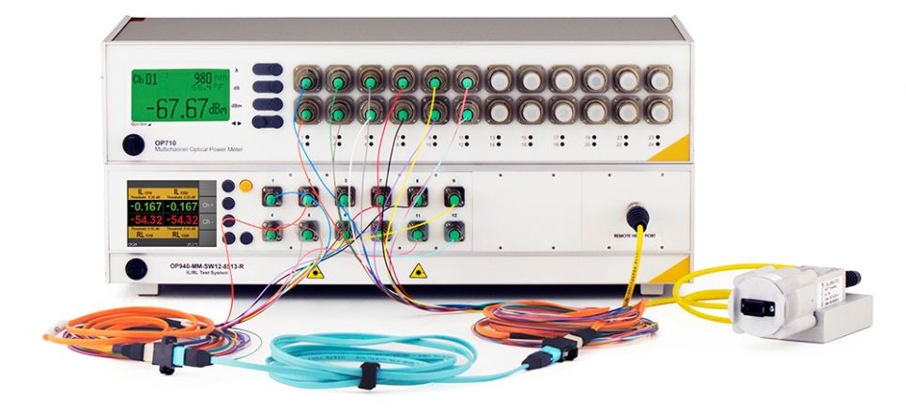
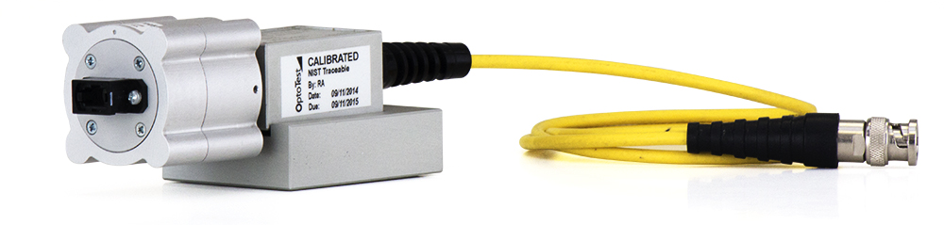
Equipment Selection
Optical Power Meter
Multichannel Power Meter
  Allows for discerning polarity in certain cases.
Integrating Sphere / Large Area Detector
  Allows for large wide aperture connectors in most cases.
  Cannot discern polarity.
Notes:
Multichannel power meter is good for testing DUTs with multiple connector types

Slide 6
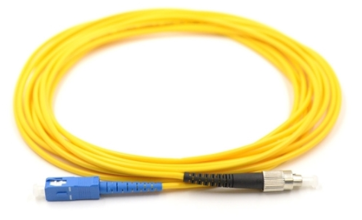
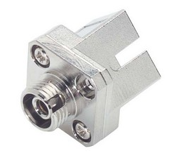
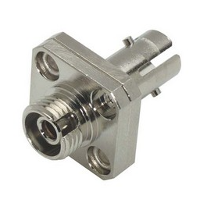
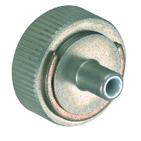
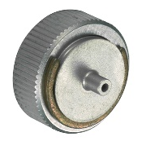
Testing Hybrid Cables
Hybrid cables are cables that have dissimilar connectors on each side:
FC-ST, FC-SC, etc.
  Similar connector types with same ferrule size and same polish angle.
  Hybrid mating adapters can be used to accommodate this testing.
  A universal OPM adapter allows for connector interchangeability.
Hybrid adapters
SC to FC hybrid cable
Universal OPM adapter

Slide 7
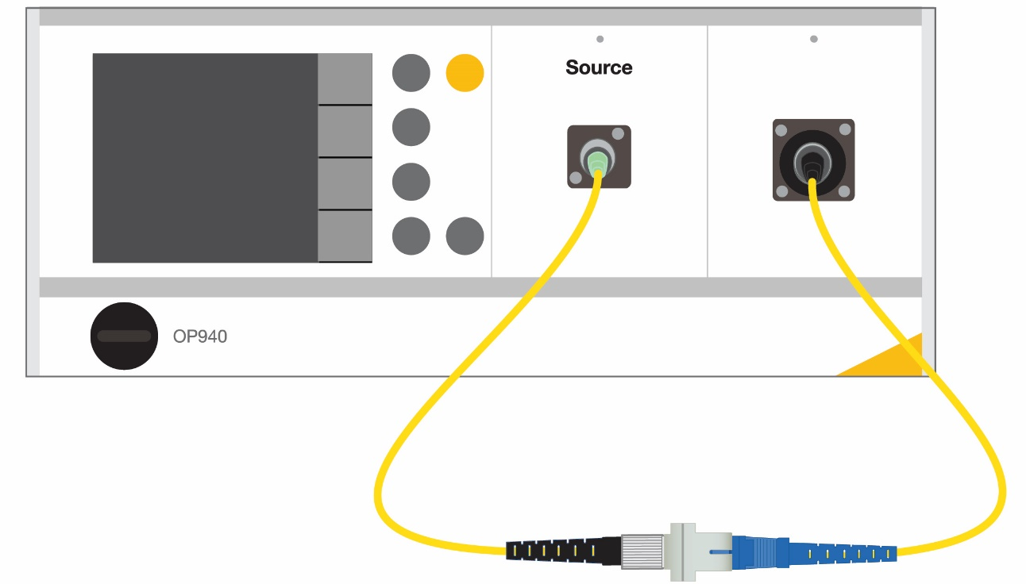
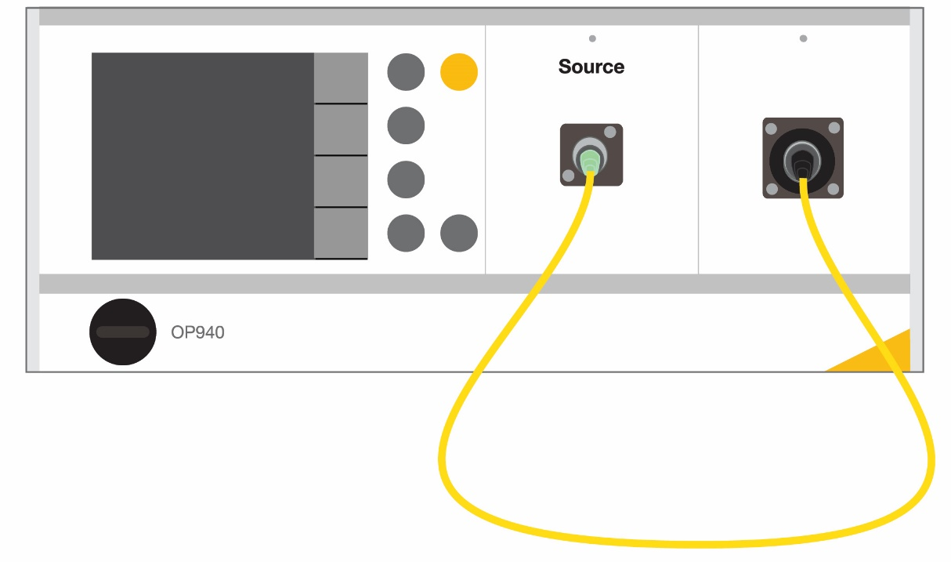
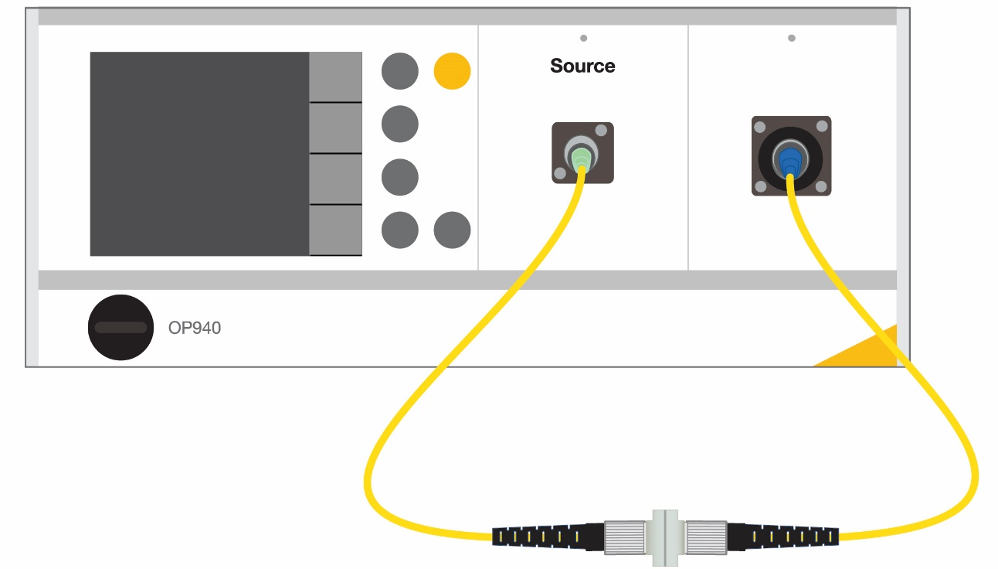
Testing Hybrid Cables
Hybrid Cable testing with inter-mateable sides.
  Example: Testing an FC-PC to SC-PC cable
    Use one reference cord with an FCPC reference connector
Reference Setup:
Connect reference connector to OPM
2.5
Testing FC side of DUT:
Using an FC-FC mating adapter test
the FC connector.
Testing SC side of DUT:
Using an FC-SC mating adapter test the SC connector.
FC-FC Mating Adapter
FC-SC Mating Adapter

Slide 8
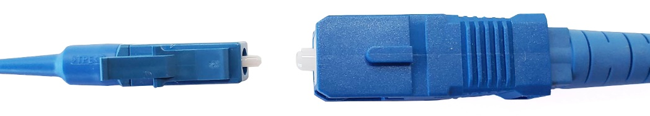
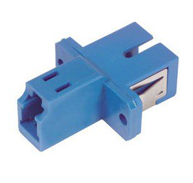
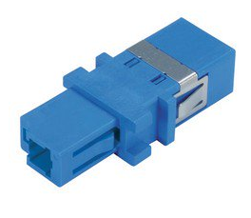
Testing Hybrid Cables
Many hybrid cables have ends that are un-mateable to each other.
  Flat connector one side and angled connector other side.
  Most common hybrid cable SC-LC.
    Unlike ferrule sizes (1.25 vs 2.5)
  SC-LC mating adapters.
    Split sleeve has different diameters.
    Produce inconsistent results.
    Shouldn’t be used for test and measurement.

Slide 9
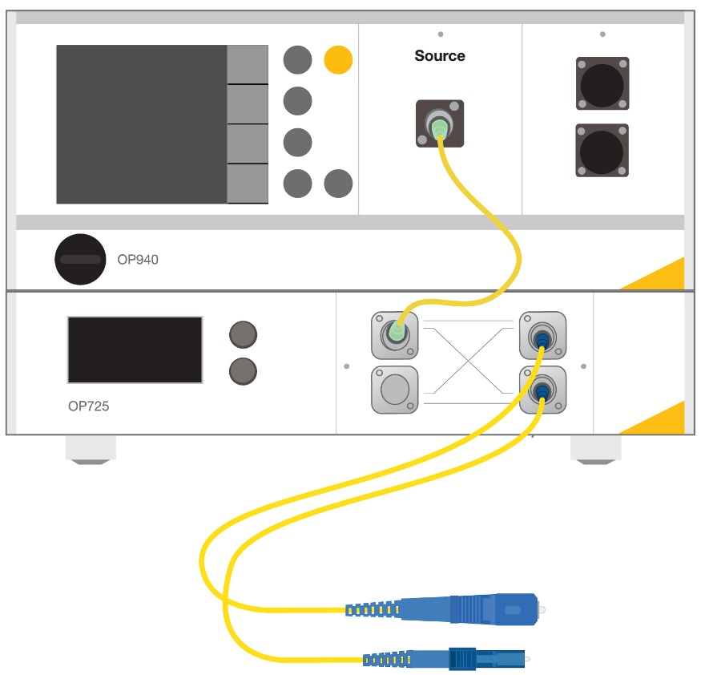
Testing Hybrid Cables
For efficient measurement of this DUT use a two-channel system.
  Two reference cables, one for the SC side and one for the LC side.
2.5
1.25

Slide 10
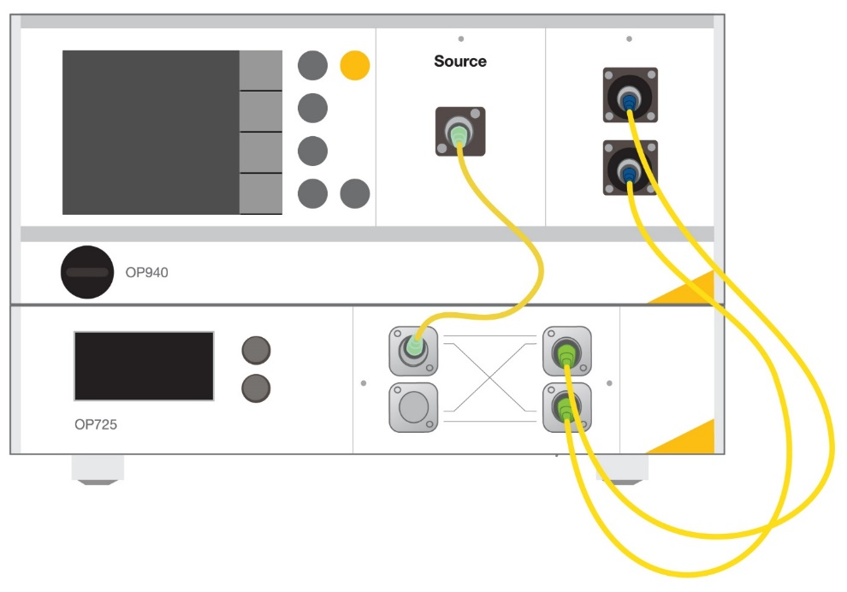
Testing Hybrid Cables
Referencing Process
2.5
1.25

Slide 11
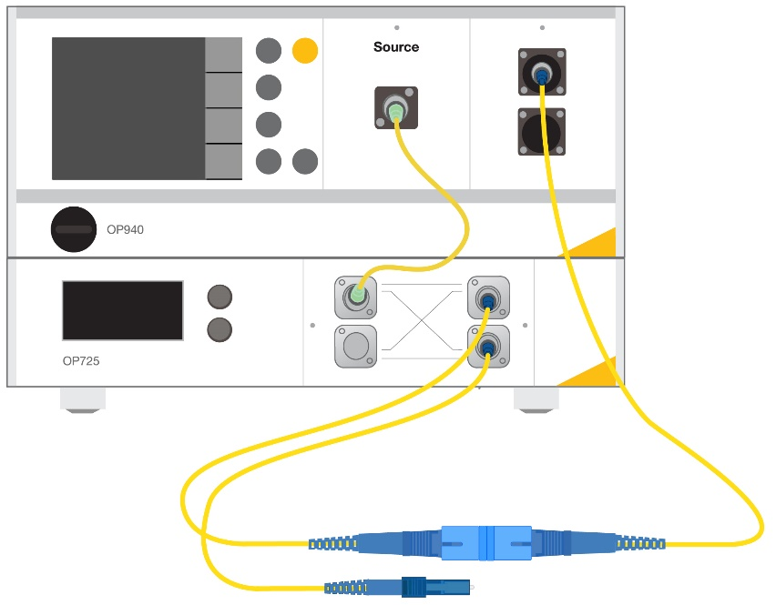
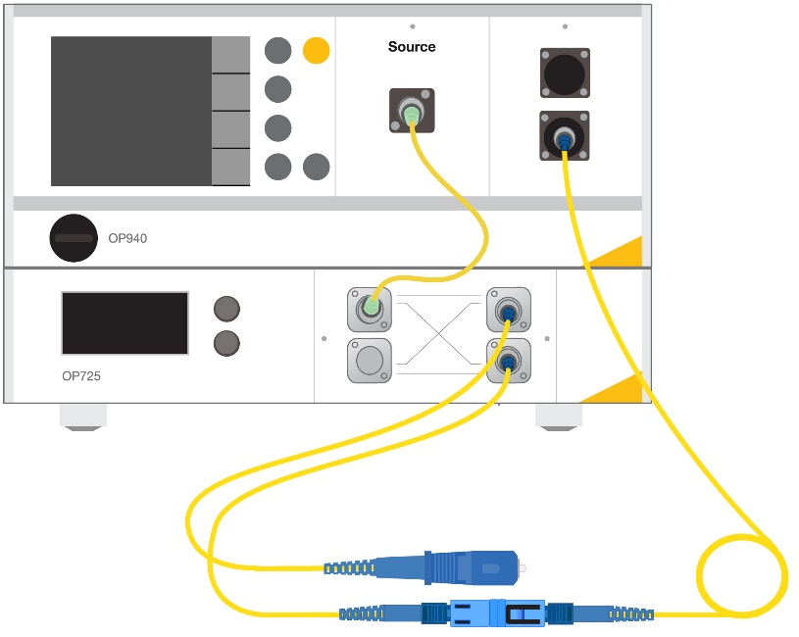
Testing Hybrid Cables
Measurement Setup
Swap the OPM adapters.
The OPM adapter swap is necessary in this case, but this process, overall is much more effective than using a hybrid adapter or swapping out reference cords.
1.25
1.25
2.5
2.5

Slide 12
Testing Hybrid Cables
Overview
  Use universal OPM adapters.
  Hybrid mating adapters for connectors that have the same ferrule size.
  For DUTs that have un-mateable ends (SC-LC)
    use a two-channel system with two reference cords. One for each side of the DUT.
    Do not use hybrid mating adapters for connectors that have unlike ferrule sizes.

Slide 13
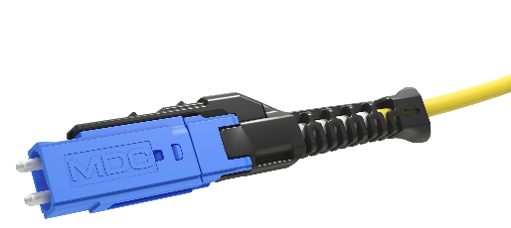
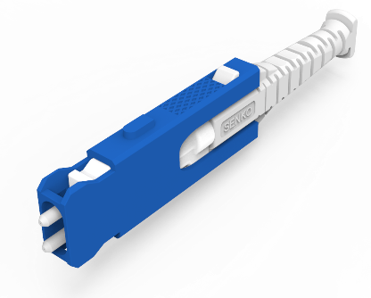

Mini Duplex Unibody Connectors
Over the past two years various duplex unibody connectors have been released:
These types of connectors are similar to a duplex LC, except there are no simplex versions of them, so one must test both ports at the same time.
  Duplex LC can be tested by using a simplex LC reference cord.
US Conec MDC Connector
Senko CS® Connector
Senko SN® Connector
Due to the wide pitch of these connectors, traditional detectors won’t capture all the light from each fiber.

Slide 14
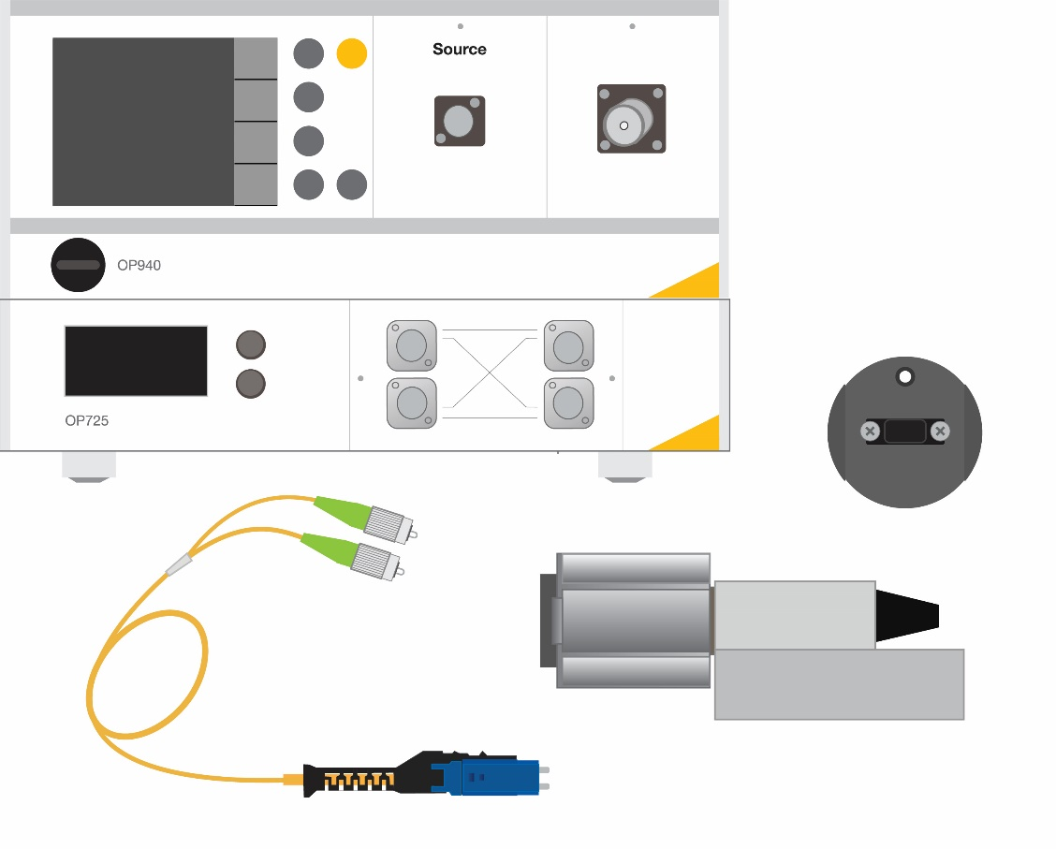
Mini Duplex Unibody Connectors
Method 1
Equipment/Cabling required:
  Two port ILRL test set.
  Large area detector or integrating sphere to capture light from both ports.
  Dedicated OPM adapter.
    CS®, MDC, SN®, etc.

Slide 15
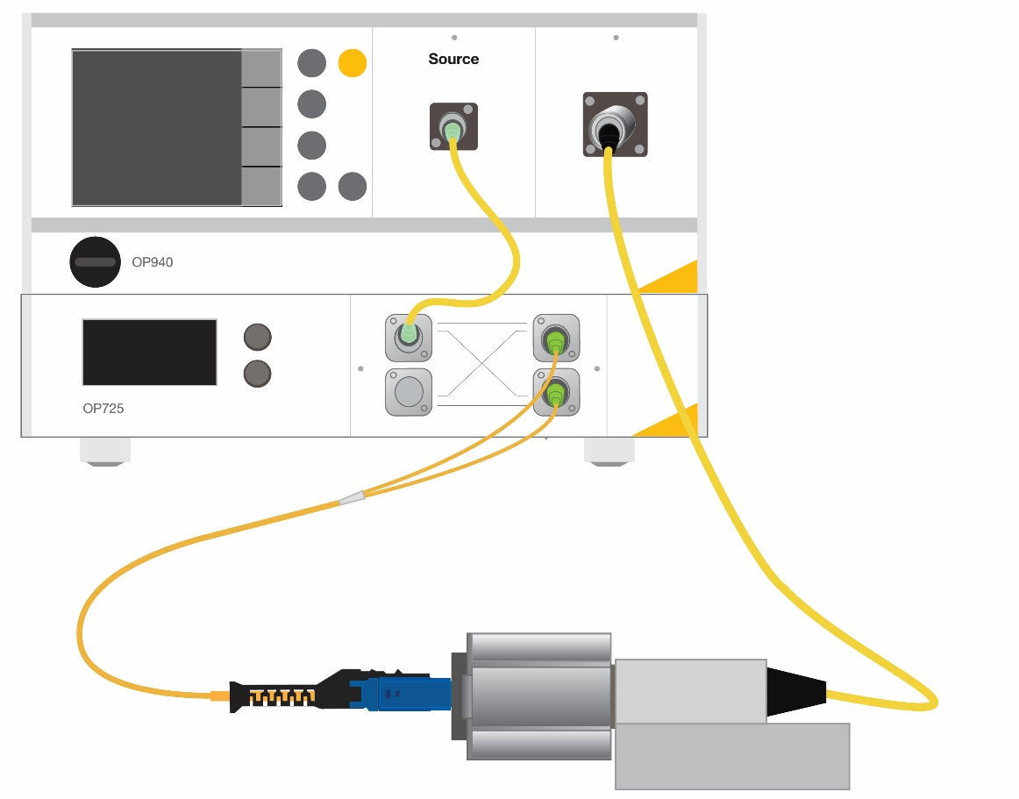
Mini Duplex Unibody Connectors
Method 1 – Referencing
Ref Cord

Slide 16
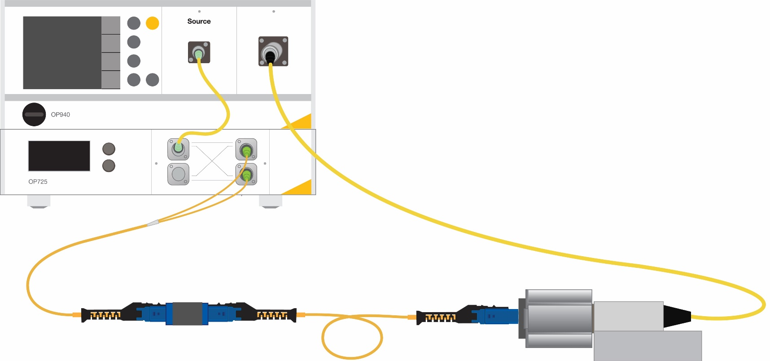
Mini Duplex Unibody Connectors
Method 1 – Measurement Setup
This method will measure IL and RL on both ports of side A of the MDC connector, however it will not validate polarity of the cable.
Ref Cord
Side A
Side B

Slide 17
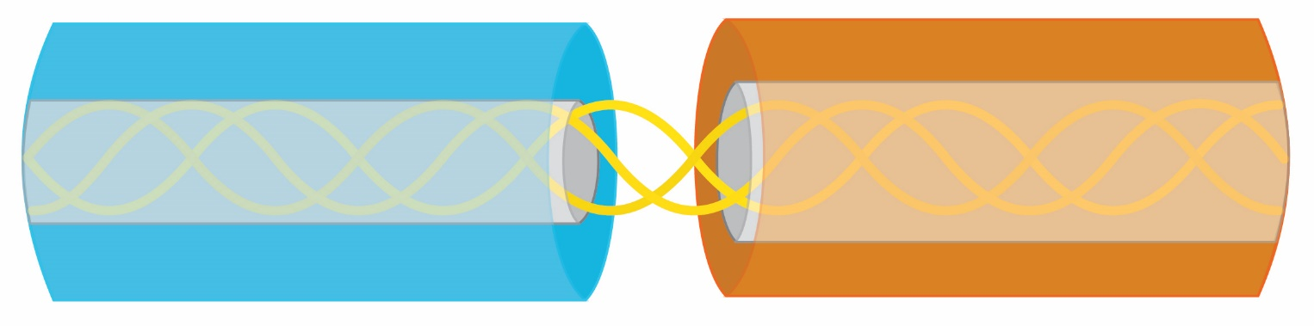
Mini Duplex Unibody Connectors
Method 2 – Large Core Breakout Receive Cable
What is the purpose of the large core breakout cable?
  Provides a zero-loss connection to route the light to the OPM.
    Effectively it is an OPM extension
  Breaks out to simplex OPMs.
Large core fiber, must be significantly larger than test fiber and have a larger NA than the test fiber.
  For 50 µm, 62.5 µm is good enough.
  For SM, 50 µm is good enough.
Notes:
Given that there are no massive issues with the connection all of the light from the smaller fiber will couple into the large core fiber and route to the OPM.

Slide 18
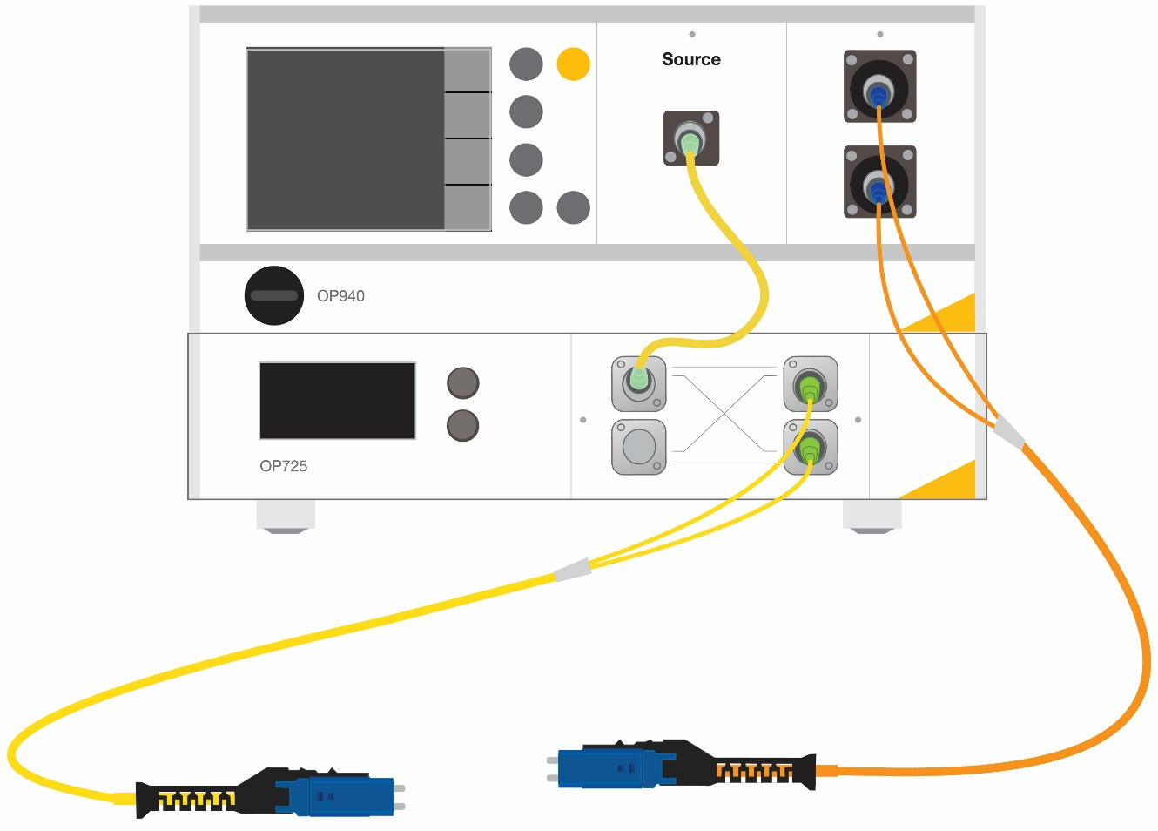
Mini Duplex Unibody Connectors
Method 2 – RL Reference
System scans to find open PC reflection.
Does this for both ports.
Launch Cord
Recv
Cord

Slide 19
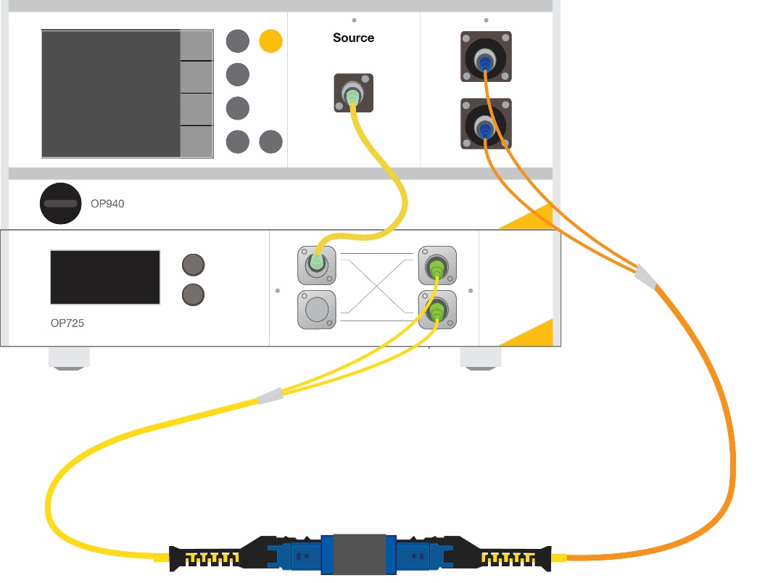
Mini Duplex Unibody Connectors
Method 2 – Referencing
The connection from the reference connector to the large core receive cable is zero loss, which simulates connecting the reference connector directly to the OPM.
  Channel 1 routes to OPM 1
  Channel 2 routes to OPM 2
Launch Cord
Recv
Cord

Slide 20
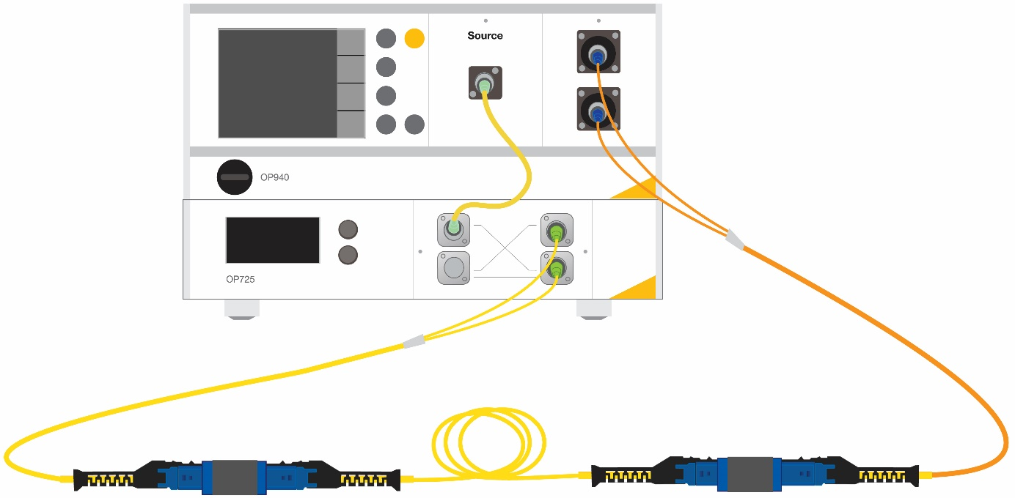
Mini Duplex Unibody Connectors
Method 2 – Measurement Setup
The connection to the receive cord is “zero” loss, so loss is dependent on the launch cord to DUT mating.
When using a receive breakout cable, light will be present on a single channel and will be expected on a single OPM. This verifies polarity.
  Crossed fibers will result in dark measurements indicating a fail.
Recv
Cord
Launch Cord
A
B

Slide 21
Mini Duplex Unibody Connectors
Large core receive cable vs dedicated non-contact OPM adapter
Receive Cable:
  Pros
    “zero” loss connection removes the contribution to the loss measurement.
    Allows for IL and polarity to be measured simultaneously.
  Cons
    Fiber to fiber mating promotes damage to connector.
      Requires inspection twice – Time consuming.
    Loss may still occur if dirt is present on receive cord connection.
Dedicated Non-Contact OPM Adapter:
  Pros
    Less Inspection
    Non-contact OPM connection.
      Reduces likelihood of damage.
  Cons
    Does not verify polarity.

Slide 22
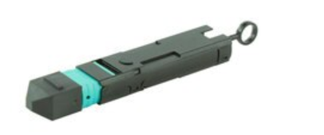
Fiber Optic Loopback Components
Loopback assemblies route fiber optic ports of a connector to fiber optic ports within the same connector.
Typically used to complete a return path from the transmit to receive side of a transceiver.
May have induced attenuation for stress testing transceivers by degrading the signal power and simulating the maximum loss budget of a system.

Slide 23

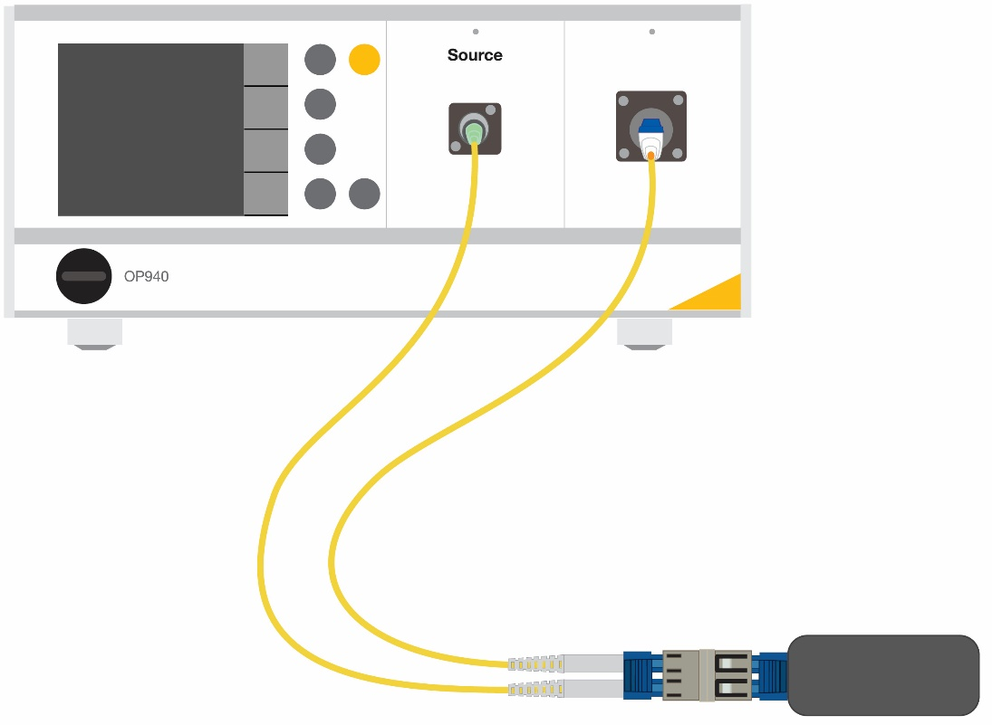
Testing Loopback Assemblies
Duplex Loop Back
  Treat this like a simplex patch cord
  Loop back has 2 ports, but only one link
Ref Cord
Recv
Cord
Ref Cord
Reference Setup
Measurement Setup

Slide 24
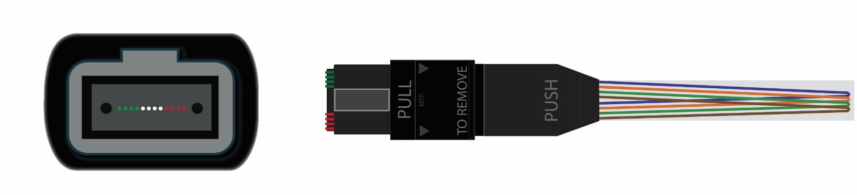
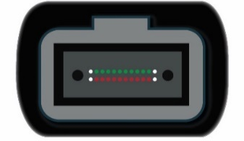
Testing Loopback Assemblies
MPO Loopback Assemblies
  One monolithic connector houses the loopback.
  Multirow loopback MPOs (24 or 32) may have the transmit and receive split between rows.
    Top row transmit and bottom row receive.
  Equipment and cabling requires unique configuration.
Example: 4 fiber loopback with 8 ports populated

Slide 25
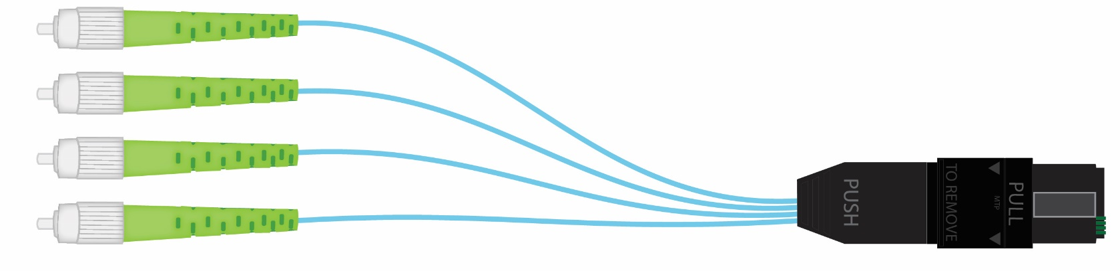
MPO Loopback Testing
Equipment Required
  Equipment cord to match loopback configuration.
    Typically half populated and based on “link” count.
Example: 4 Fiber fanout (only Ch1 to Ch4)

Slide 26
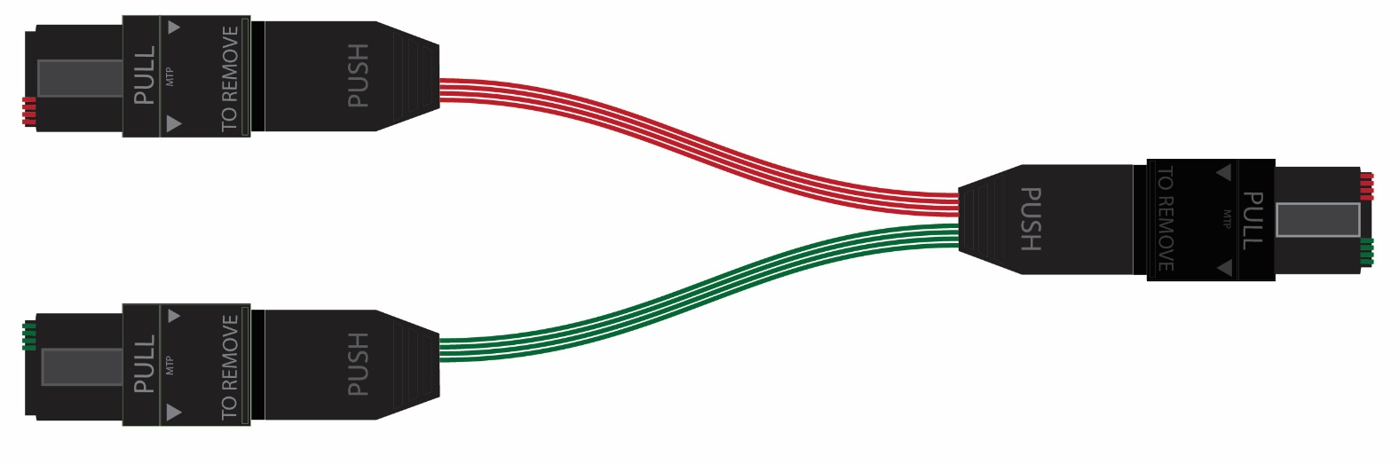
MPO Loopback Testing
Equipment Required
  Launch/Return cord.
    Complicated fanout.
Notes:
2 4 fiber MPOs to 1 8f MPO
On the 8f and 4 fiber MPOs make sure fully populated. Open fiber ports gather dirt.

Slide 27
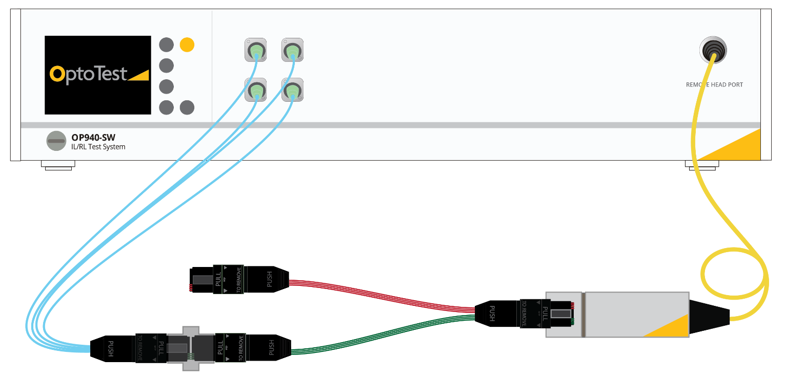
MPO Loopback Testing
Equipment Required
  Multichannel optical source (RL if necessary).
  Large area detector (or integrating sphere) to accommodate the MPO connector.
Type A adapter
Key-up / Key-down

Slide 28
MPO Loopback Testing
Referencing Process
Type A adapter
Key-up / Key-down

Slide 29
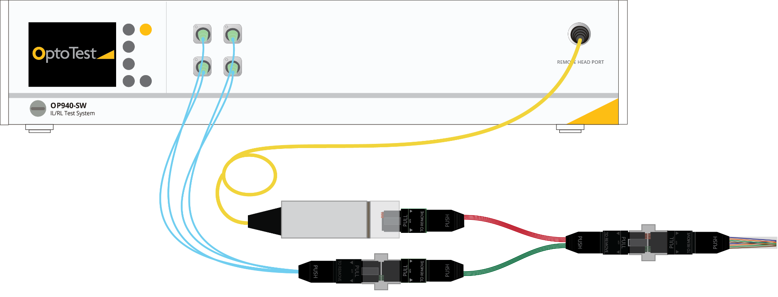
MPO Loopback Testing
Measurement Setup

Slide 30
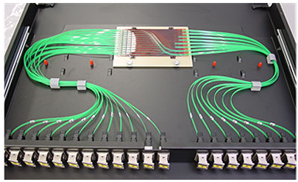
Shuffle Testing
Optical shuffles are fiber optic assemblies that route many inputs to many outputs.
  Testing these can be time consuming and ultimately confusing.
  Many times a “deshuffle” assembly can be used to “reorganize” the links to a manageable testing scenario.

Slide 31
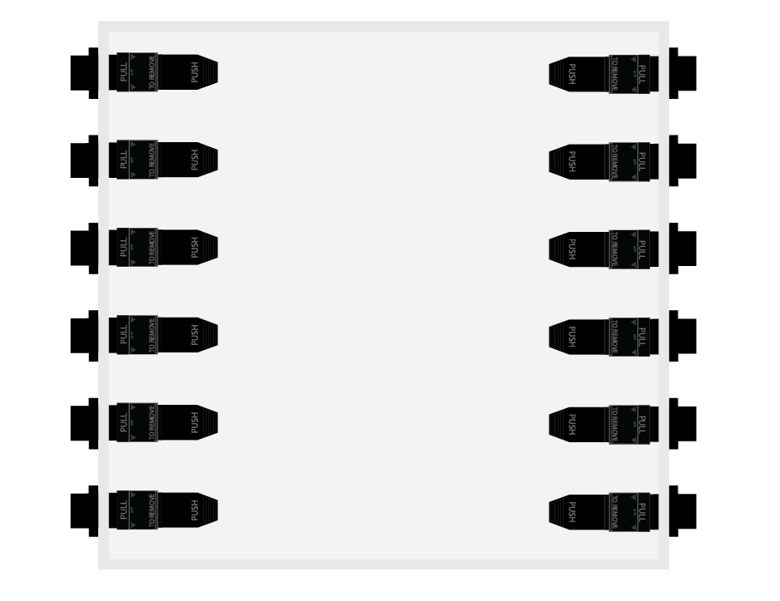
Shuffle Testing
Input |  |  | Output
Conn | Port |  | Conn | Port
1 | 1 |  | 1 | 1
1 | 2 |  | 2 | 1
1 | 3 |  | 3 | 1
1 | 4 |  | 4 | 1
1 | 5 |  | 5 | 1
1 | 6 |  | 6 | 1
2 | 1 |  | 1 | 2
2 | 2 |  | 2 | 2
2 | 3 |  | 3 | 2
2 | 4 |  | 4 | 2
2 | 5 |  | 5 | 2
2 | 6 |  | 6 | 2
3 | 1 |  | 1 | 3
3 | 2 |  | 2 | 3
3 | 3 |  | 3 | 3
3 | 4 |  | 4 | 3
3 | 5 |  | 5 | 3
3 | 6 |  | 6 | 3
4 | 1 |  | 1 | 4
4 | 2 |  | 2 | 4
4 | 3 |  | 3 | 4
4 | 4 |  | 4 | 4
4 | 5 |  | 5 | 4
4 | 6 |  | 6 | 4
5 | 1 |  | 1 | 5
5 | 2 |  | 2 | 5
5 | 3 |  | 3 | 5
5 | 4 |  | 4 | 5
5 | 5 |  | 5 | 5
5 | 6 |  | 6 | 5
6 | 1 |  | 1 | 6
6 | 2 |  | 2 | 6
6 | 3 |  | 3 | 6
6 | 4 |  | 4 | 6
6 | 5 |  | 5 | 6
6 | 6 |  | 6 | 6
Sample Shuffle
  6 MPO connectors with 6 fibers populated.
  Each fiber of each input connector routes to the corresponding port of the output connectors.

Slide 32

Shuffle Testing
A straight-forward test method suggests testing one link at a time.

Slide 33
Shuffle Testing
For a much simpler test method use a “deshuffle” assembly.
  This assembly inverses the effects of the shuffle and greatly simplifies the test.
Reference by connecting your reference cord to the large area detector.

Slide 34

Shuffle Testing
For a much simpler test method use a “deshuffle” assembly.
  This assembly inverses the effects of the shuffle and greatly simplifies the test.
Notes:
If deshuffle is made with same fiber, then link loss
- From larger core fiber, then its one-sided.

Slide 35
Shuffle Testing
Overview
  There is no “one size fits all” approach.
    Depends on connectors used, polarity, etc.
  A de-shuffle assembly greatly reduces the amount of connects/disconnects to the DUT.
    Simplifies the testing process greatly
  A de-shuffle of the same core size, will produce a “link loss” result.
    Both connections are included in the measurement.
  A de-shuffle with a large core fiber, will produce a one-sided loss result.
    Large core fiber is a “zero” loss connection.

Slide 36
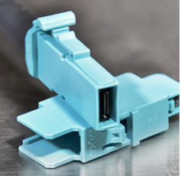
Expanded Beam connectors
Multiple expanded beam options available
  EBO (3M), MXC, Prism (LT-MT), various ruggedized military grade options
  Drive to build connectors that are easily installed
    Dust resistant/resilient
    Non-contact
      Inspection and cleaning less necessary due to lower likelihood of damage due to mating.
80um
~11% -> 0.5dB
9um
~.14% -> 0.01dB
3um

Slide 37
Expanded Beam Connectors
Many of these connectors don’t have standard OPM adapters available.
  Due to large spot size there might be interference with standard OPM adapter apertures.
  Devise methods to couple light into OPM.
These are non-contact connectors and sometimes the return loss is a function of one termination in the mating, rather than a combination of both.
  For standard physical contact connectors it is assumed that the return loss of a connection is independent of direction.
RL_{A->B}
≈
RL_{B->A}
RL_{A->B}
<
RL_{B->A}

Slide 38
Expanded Beam Connectors
Non-contact connectors
  Return loss governed by “source-side” connector.
  Rays incident on the receive side connector are reflected away from the source connector and likely don’t couple into the source-side fiber.

Slide 39
Expanded Beam Connectors
Where to test RL?
REF
DUT
REC
A
B
C
D
RL_{A}
RL_{C}
RL_{B}
Notes:
When measuring standard fiber assemblies the connection at the reference cord is measured, however, this only yields information about the reference cord connector and not the DUT.

Slide 40
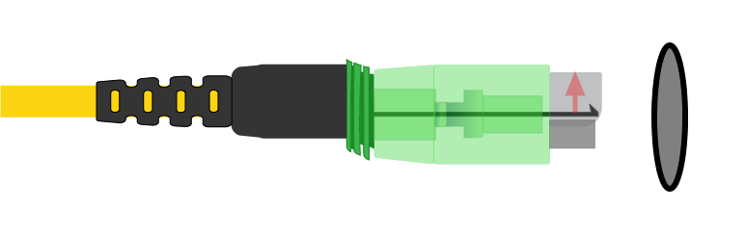

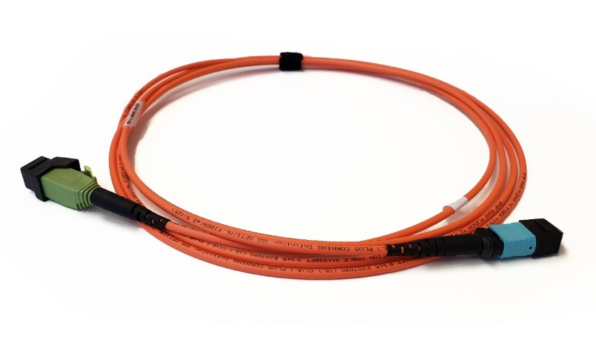
Expanded Beam Assemblies (EBO)
EBO Assemblies
  90° non-contact assembly
  Enclosed and shrouded
  No easy way to couple the connector into an OPM and accurately capture the light
  Employ a large core receive cord and treat like standard MPO type testing

Slide 41
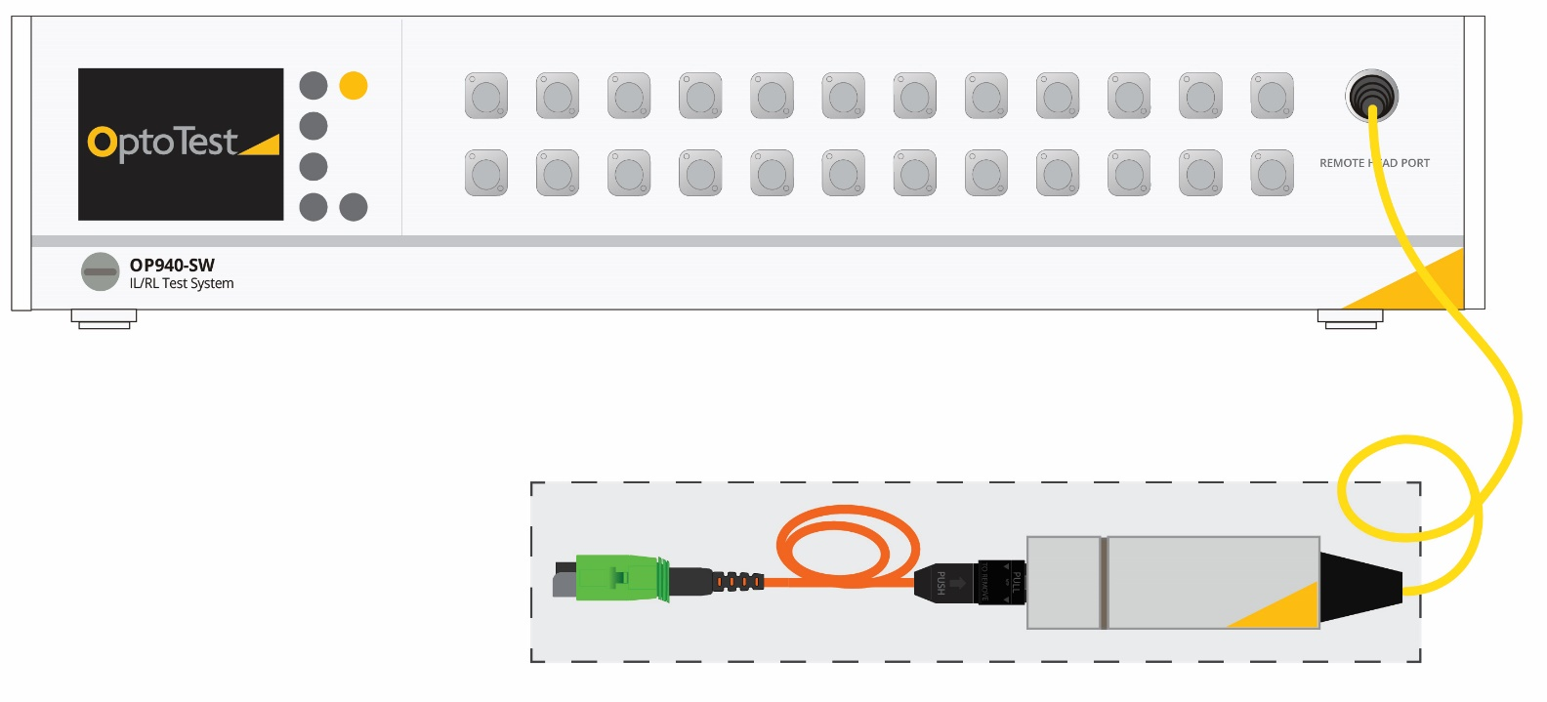
Expanded Beam Assemblies (EBO)
Large core receive cable
  EBO to MPO assembly built from 62.5um fiber.
  Serves to couple the light from the EBO assembly to the OPM.
  MPO OPM adapters are standard and readily available.

Slide 42

Expanded Beam Assemblies (EBO)
Equipment and Cabling Setup
Equipment cord
Launch cord
Recv cord

Slide 43


Expanded Beam Assemblies (EBO)
IL Reference
  Connect the EBO reference cord to the Large core receive fiber.
RL Reference
  System scans for open end of cable.
  Connect short EBO to MTP-PC assembly for RL reference and calibration verification and “zero” to 14.7dB.
Notes:
These open EBO assemblies have very low return loss, OptoTest suggests using a short EBO to MTP flat assembly to induce a know return loss. This serves two purposes: 1 is to present the system with a large reflection that is easy to find and second it presents the system with a reflection standard to help the system self calibrate to a 14.7dB reflection. Once the RL reference is complete disconnect this short stub.

Slide 44

Expanded Beam Assemblies (EBO)
To measure the loss of the EBO connector, mate the assembly between the reference connector and the receive cable connector.
A
B

Slide 45
Expanded Beam Assemblies (EBO)
What to expect when testing expanded beam assemblies?
  To reference return loss use a short EBO to MTP flat connector to “zero” the reflection to 14.7dB.
  For 3M EBO connector pay attention to potential dust contamination on large core receive cable.
    Daily usage will lead to potential dust buildup.
  To clean use compressed air to blow away dust.
Measure return loss at the “right” location.
  Depends on connector type – contact vendor.

Slide 46
1.805.987.1700
www.optotest.com
support@optotest.com

